Slide 1

I wish you a happy Lunar New Year.
I wish you all great success, happiness, and prosperity in the Year of the Rat.

Slide 2

Our Group Member:
Name Student ID
Minh Khoi Phan 170262
Huy Hung Nguyen 102825
Nico

Slide 3



Slide 4
A Website for selling clothes Online
Anyone can use even kids
Every step of transaction is simple as much as possible

Slide 5
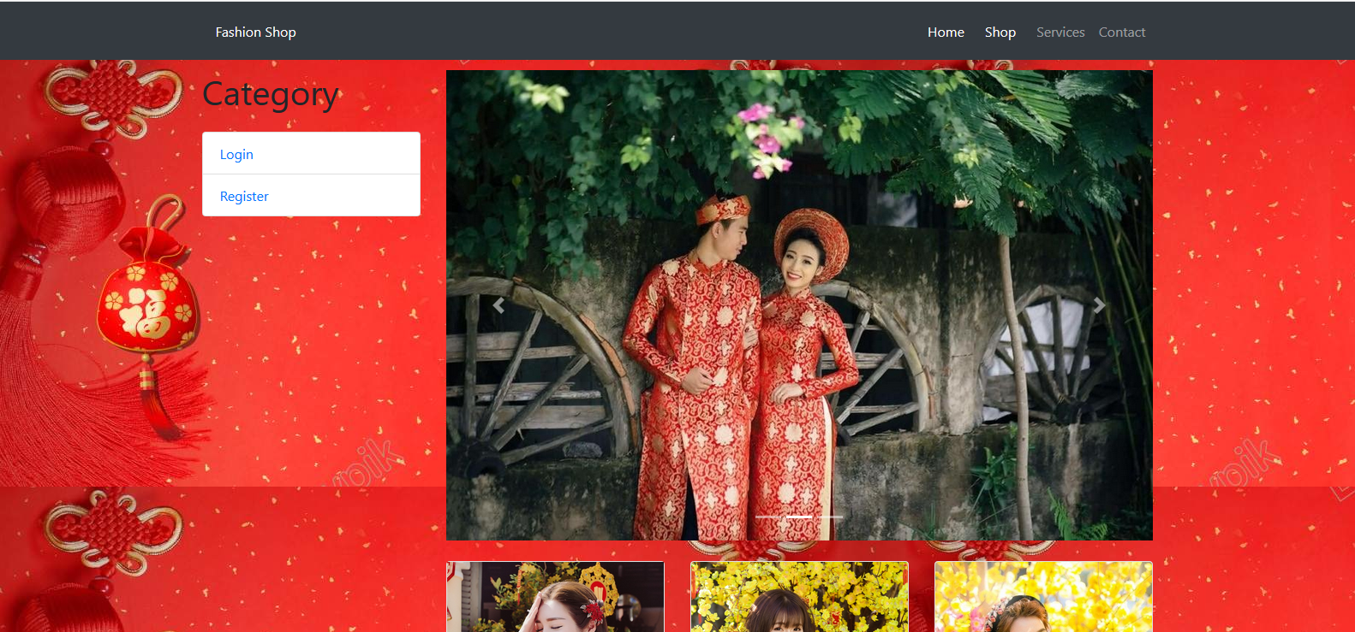

Slide 6
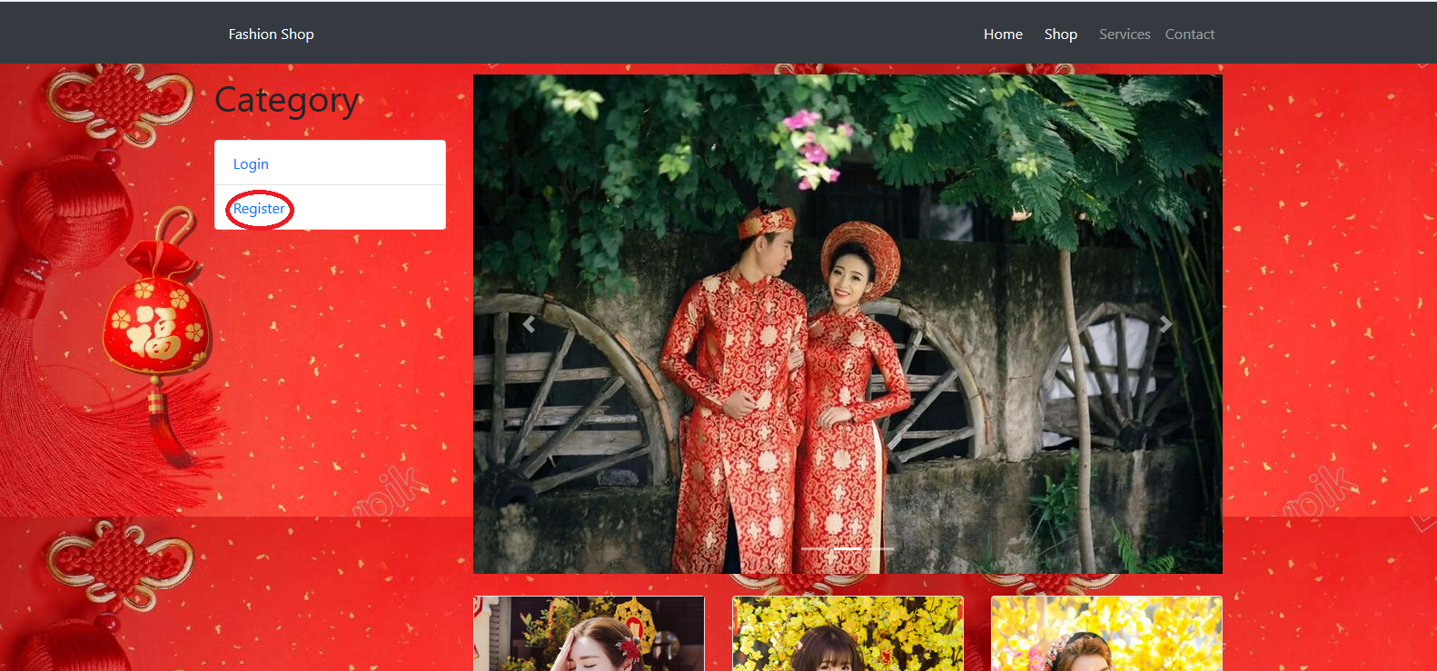

Slide 7
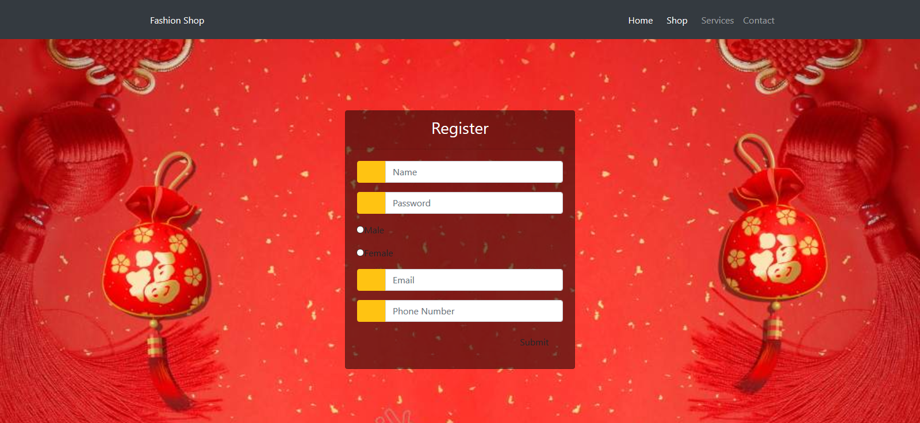

Slide 8
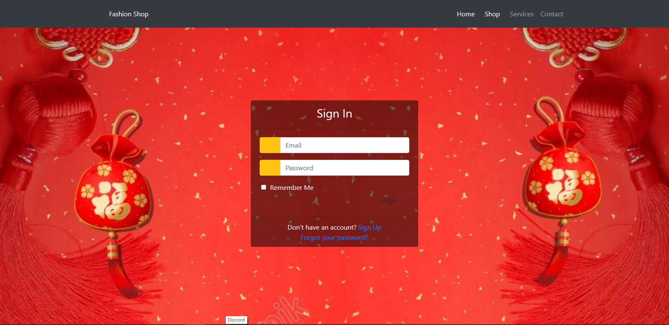

Slide 9
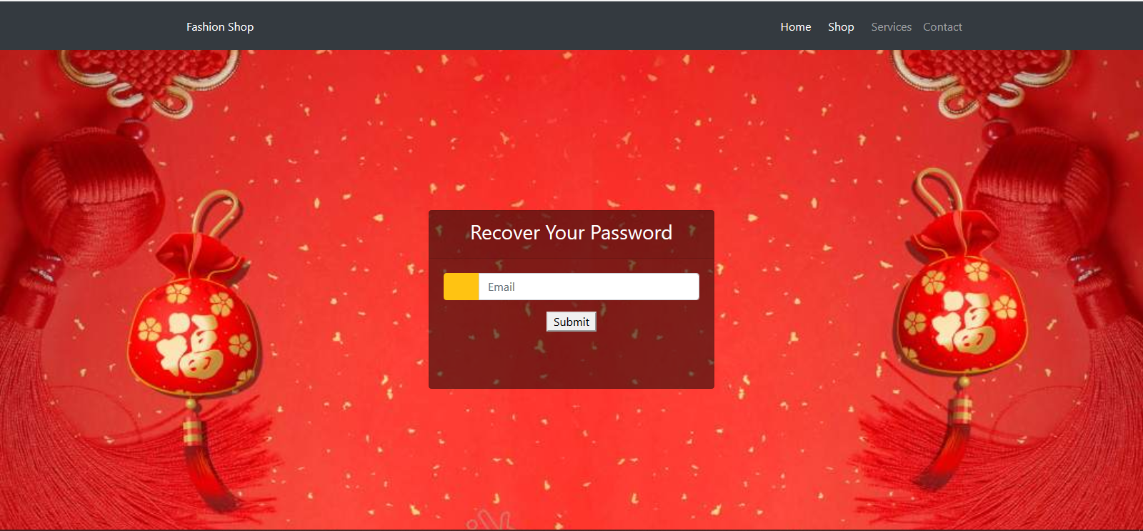

Slide 10
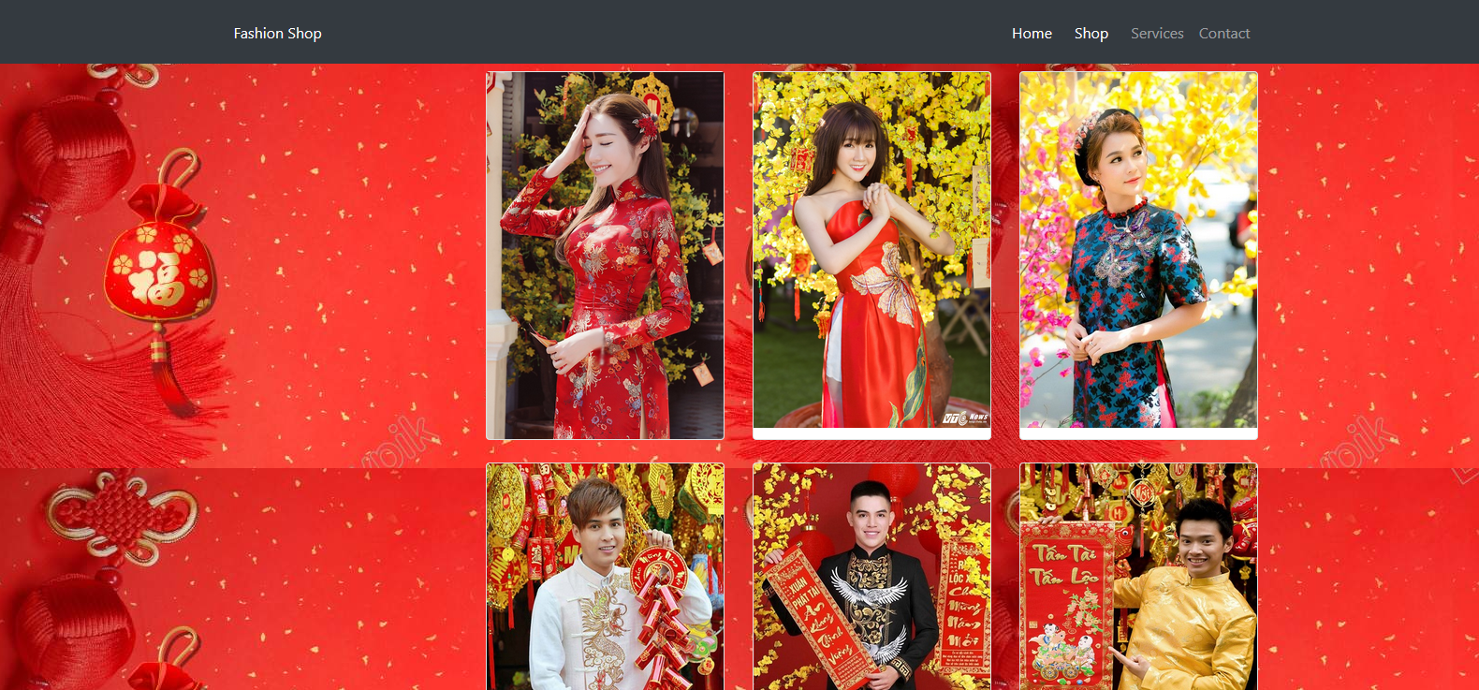

Slide 11
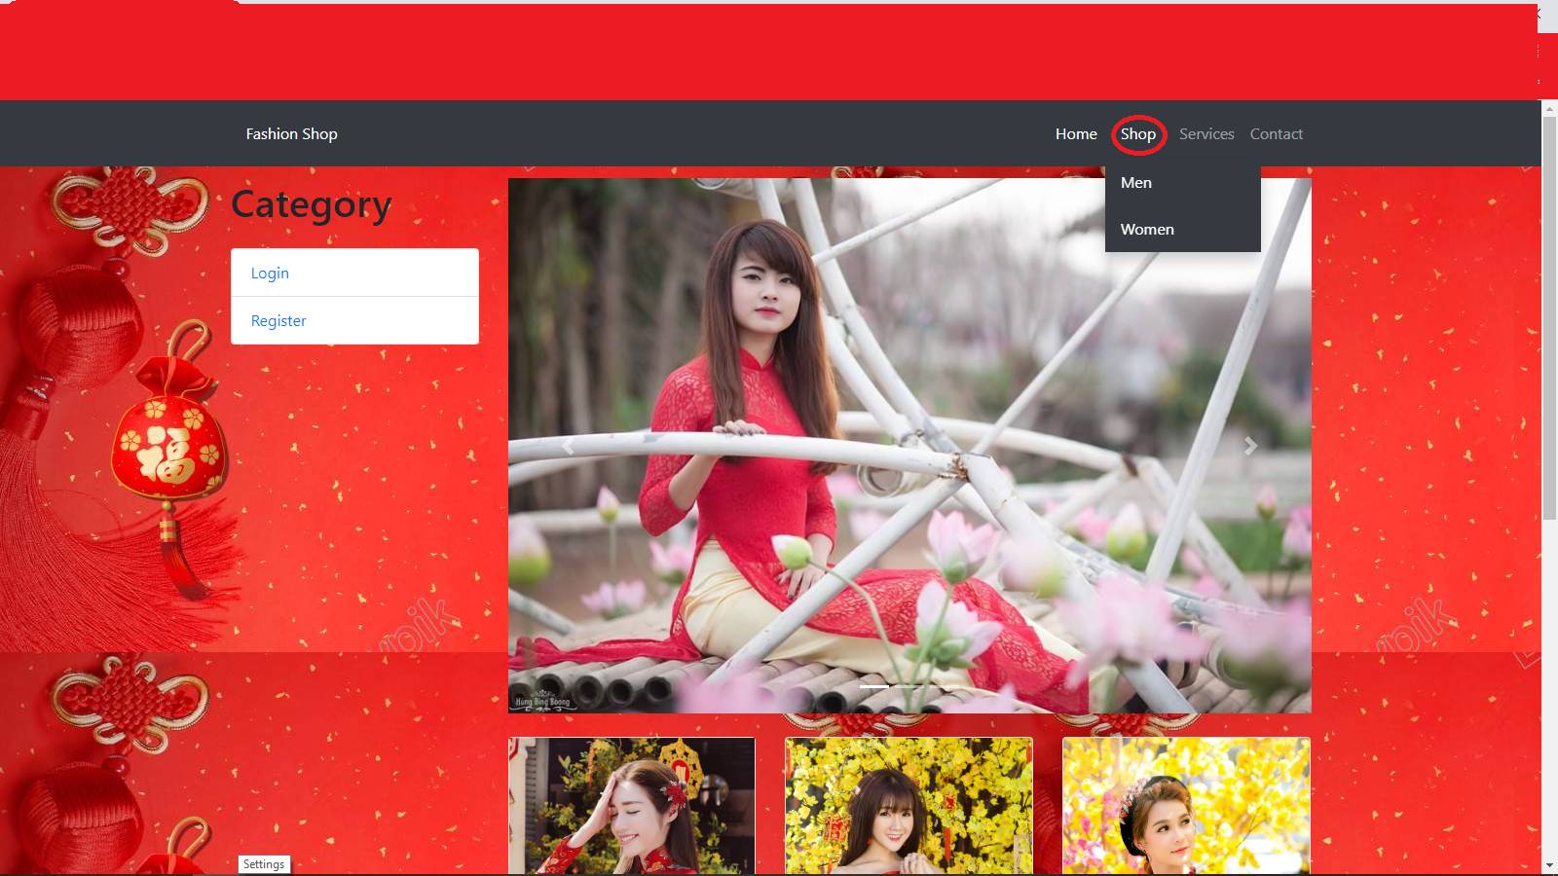

Slide 12
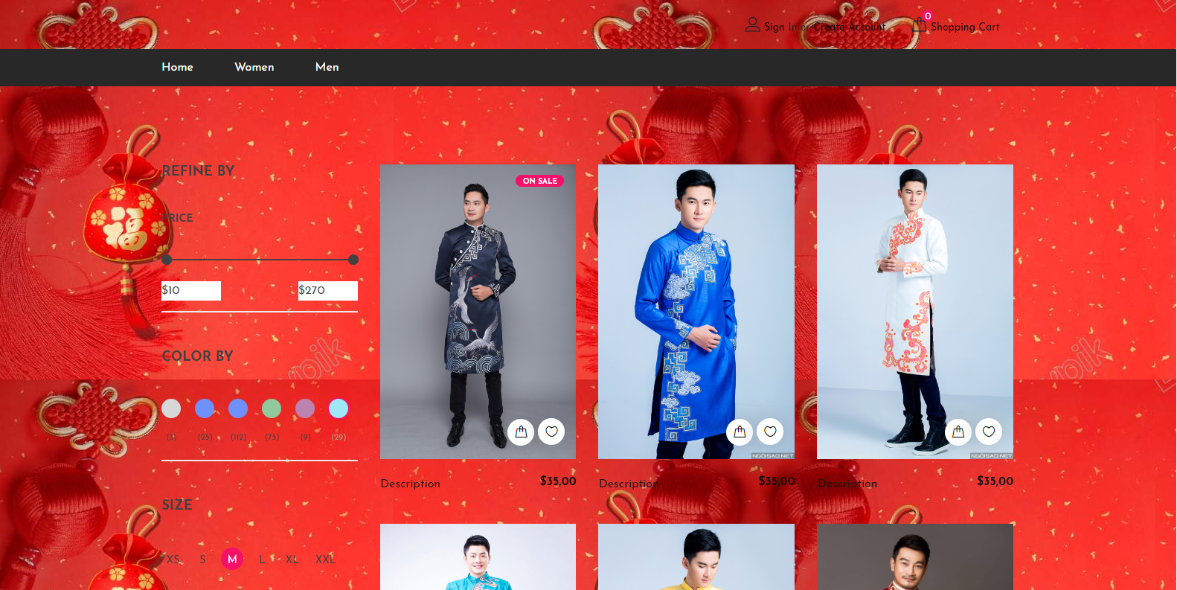

Slide 13
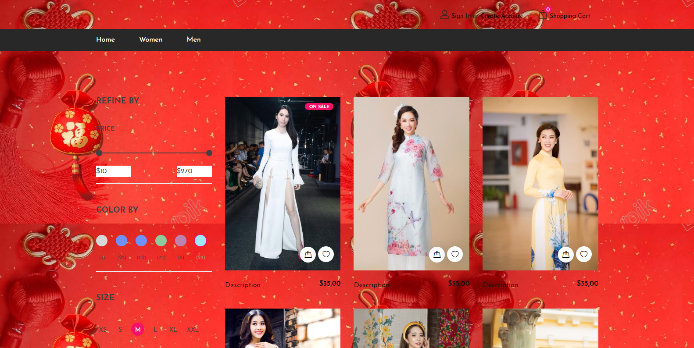

Slide 14
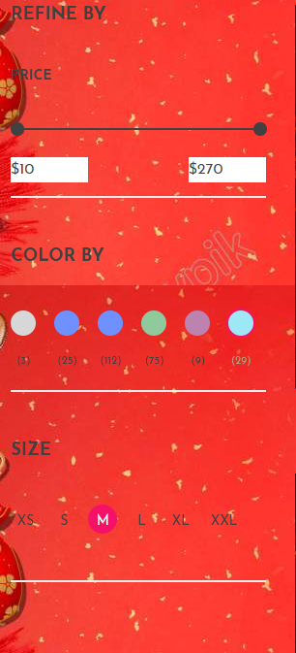

Slide 15
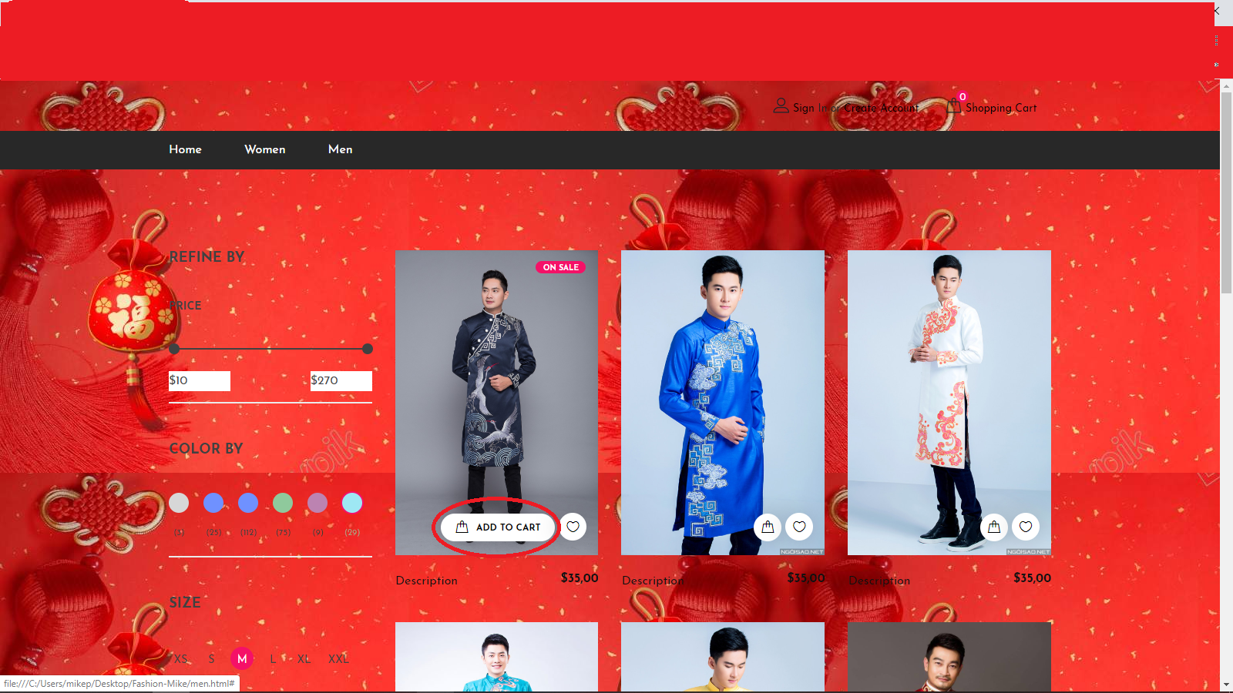

Slide 16
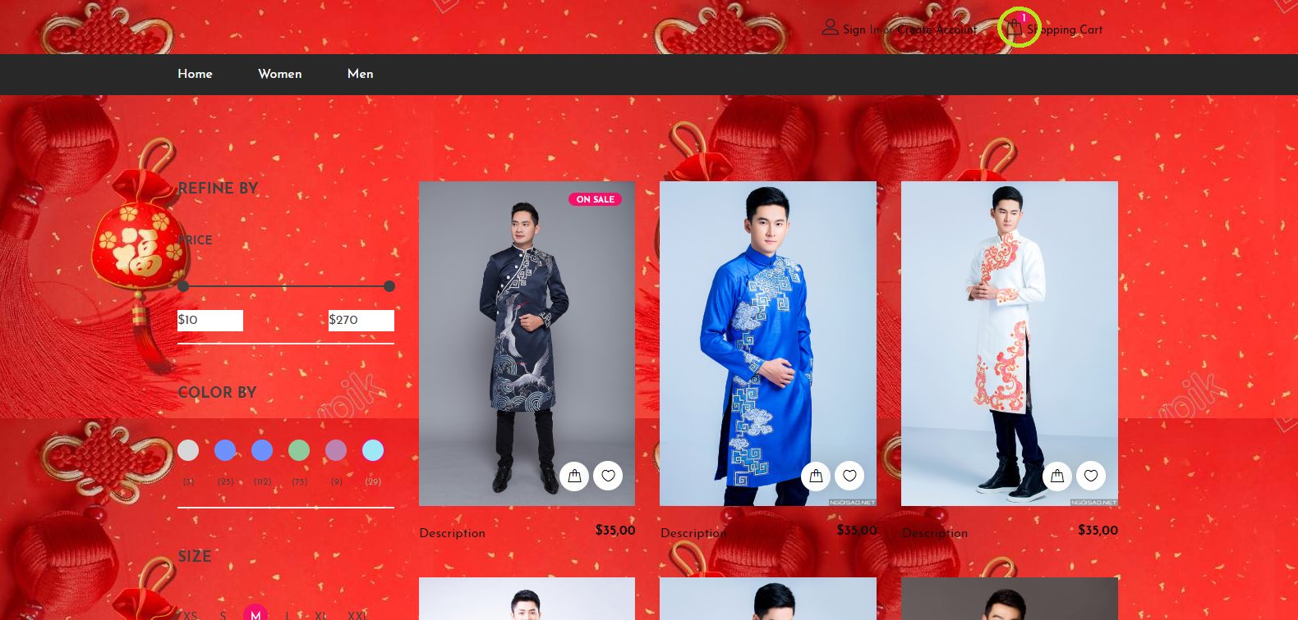

Slide 17
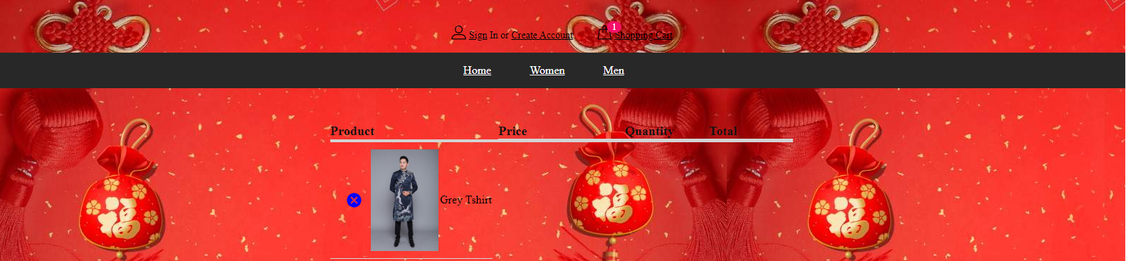

Slide 18
THANK YOU

